Slide 1
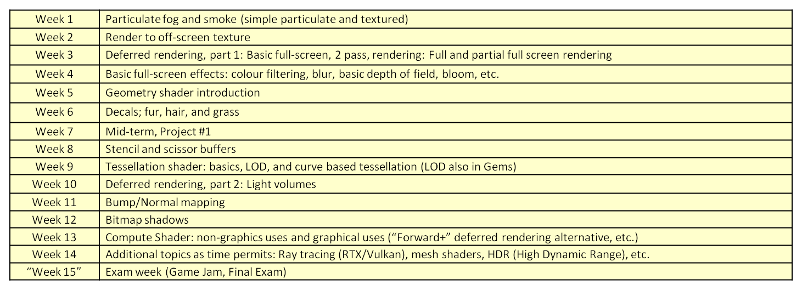
Proposed schedule (2024)
INFO-6020 Graphics 2, Winter 2024, mfeeney@fanshawec.ca, Michael Feeney

